Slide 1
Ted Analysis
Network Spatial Analysis

Slide 2
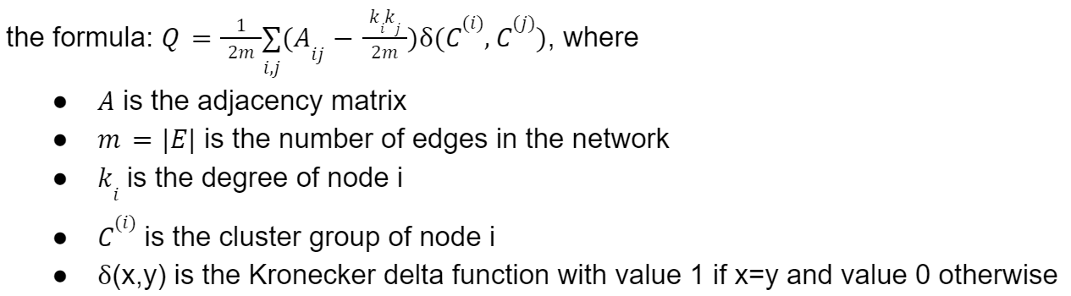

Network Visualization
‘related_talks’ → edges
Identify clusters by network modularity $Q∈\left[−1,1\right]$
Gephi’s modularity clustering method → Q=0.5, 6 clusters
Notes:
Using the related talk column in dataset as the edges of the network, we created a network visualization.
Then we try to use modularity analysis to identify clusters within the network. Modularity is a measure of community structure within the network, which ranges from -1 to 1. A high modularity indicates the presence of clusters.
Using the modularity clustering function in Gephi, we get a modularity score of 0.5 and 6 clusters for our network.

Slide 3
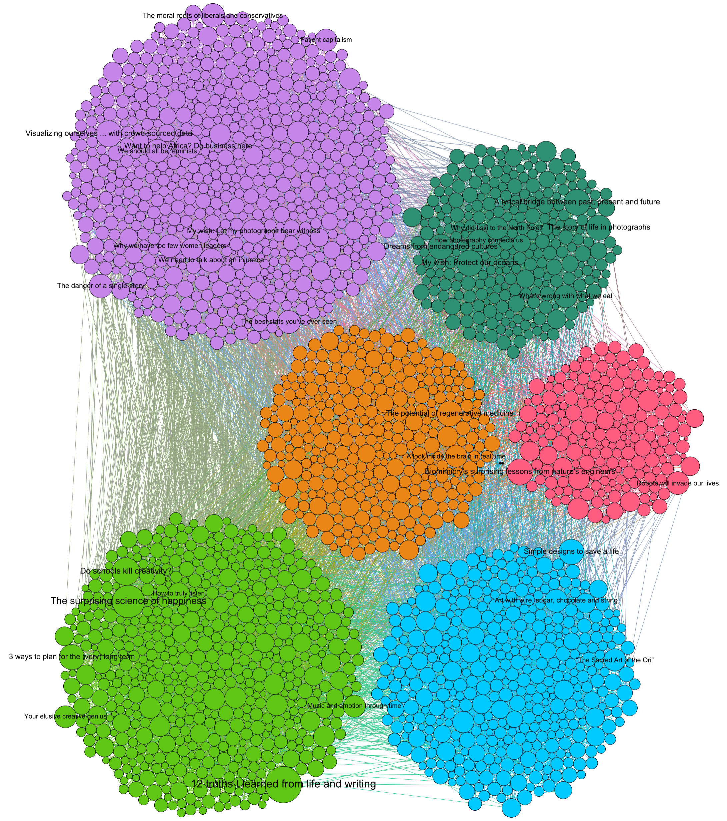
Network Visualization
Nodes grouped by their modularity class
Talk title of nodes with high degree are shown
Common theme within clusters
Notes:
Then we group the nodes by their corresponding modularity cluster to get this visualization.
We show the talk title of the nodes with high degree. As a result we observe the common theme in each cluster.

Slide 4
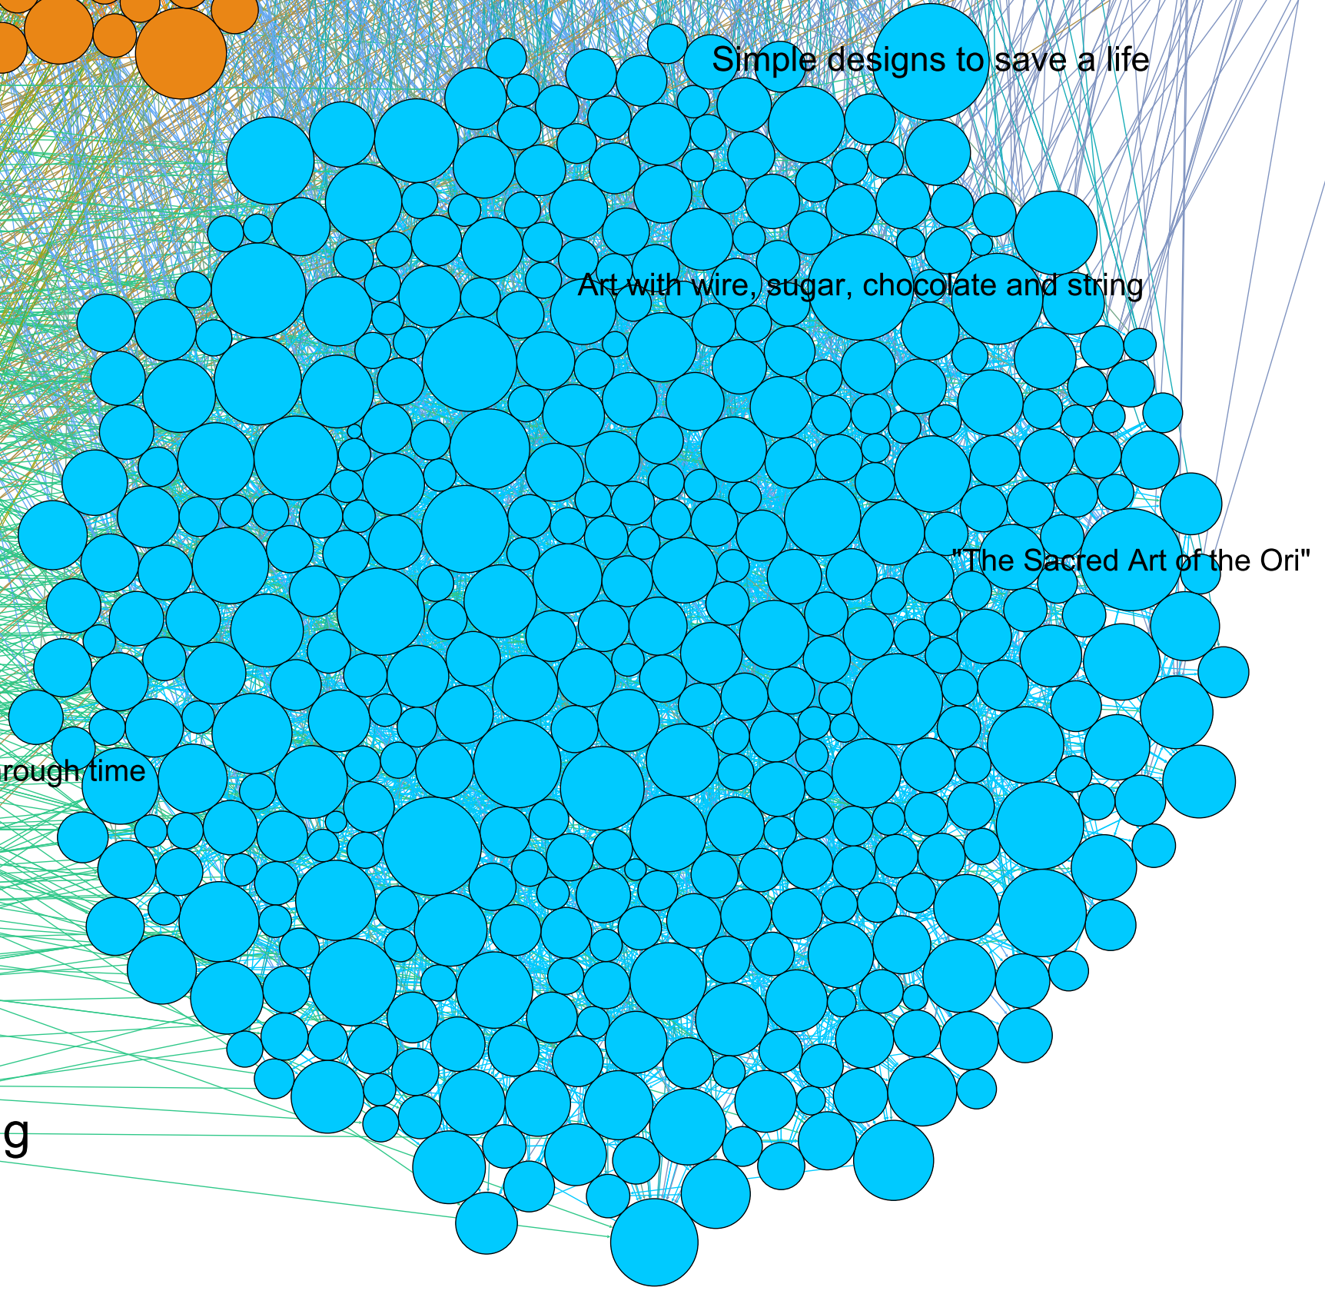
Network Visualization
Cyan cluster’s common theme: arts and design
‘Simple designs to save a life’
‘Art with wire, sugar, chocolate and string’
‘The Sacred Art of the Ori’
Notes:
For example, the cyan cluster has a common theme of arts and design, as can be seen by the its popular talk titles listed here

Slide 5
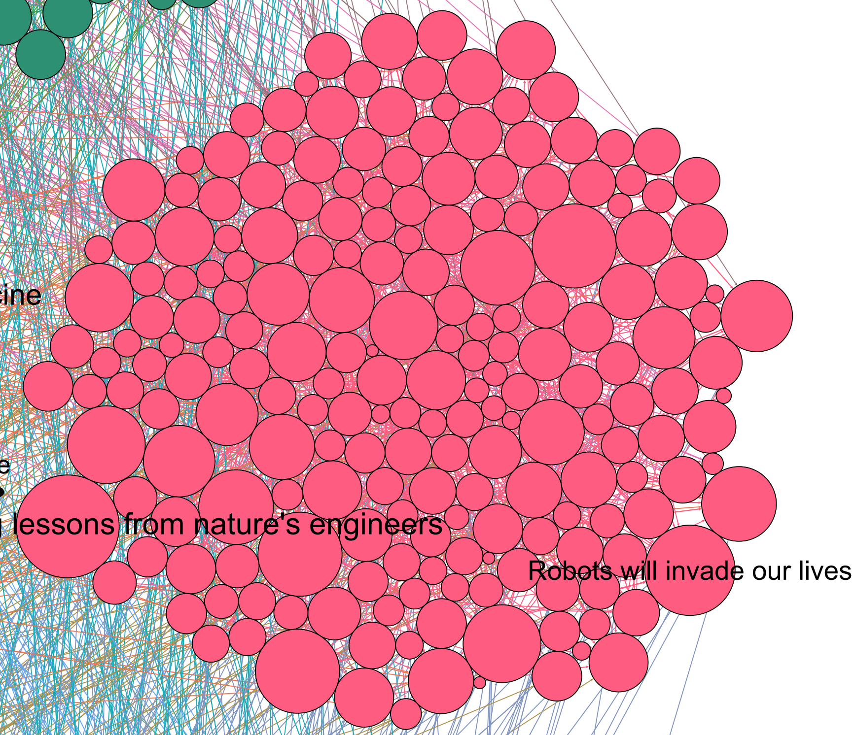
Network Visualization
Red cluster’s common theme: engineering and technology
‘Biomimicry’s lessons from nature’s engineers’
‘Robots will invade our lives’
Biomimicry’s
Notes:
And the red cluster has a common theme of engineering and technology, as can be seen by the major talk titles.

Slide 6
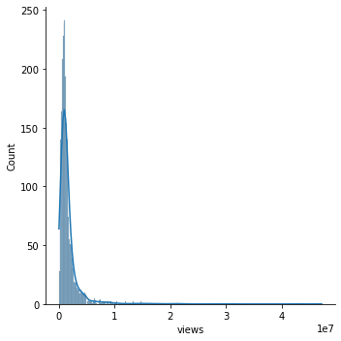
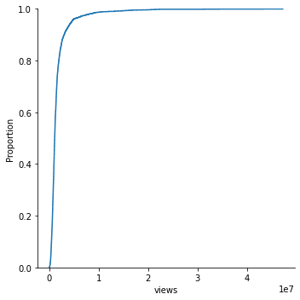
Views Distribution

Slide 7
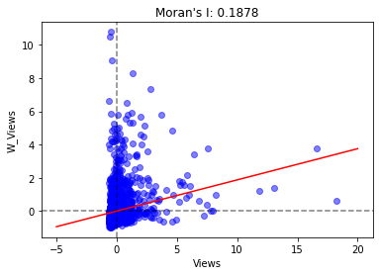
Correlation Analysis: Moran’s I
Converting the network into spatial adjacency matrix
Wij = 1 if connected by edge
The global metrics, Moran’s I shows a positive weak spatial correlation
Randomness hypothesis:
statistically significant
Expected value E(I) | Variance VAR(I) | Z score
-3.9231e-03 | 8.6938e-05 | 20.1828

Slide 8
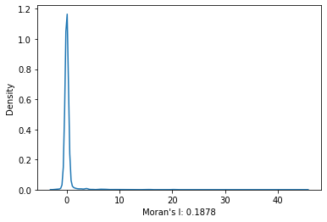
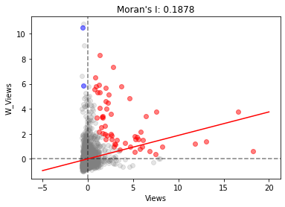
Clustering Analysis: LISA
Title | LISA | E(Ii) | VAR(Ii) | Z Score
Do schools kill creativity? | 9.6962 | -0.0004 | 0.9446 | 9.9771
Averting the climate crisis | -0.1395 | -0.0004 | 0.9582 | -0.1421
Simplicity sells | -0.0015 | -0.0004 | 0.9582 | -0.0011
Greening the ghetto | 0.0001 | -0.0004 | 0.9582 | 0.0005
The best stats you've ever seen | 0.3454 | -0.0004 | 0.9576 | 0.3533
By computing LISA, it provides the clustering effect among the ted talks
Using a 95 percent confidence level, red points are the ted talks with high LISA and blue points are the ted talks with low LISA.
Notes:
http://ceadserv1.nku.edu/longa//geomed/ppa/doc/LocalI/LocalI.htm

Slide 9
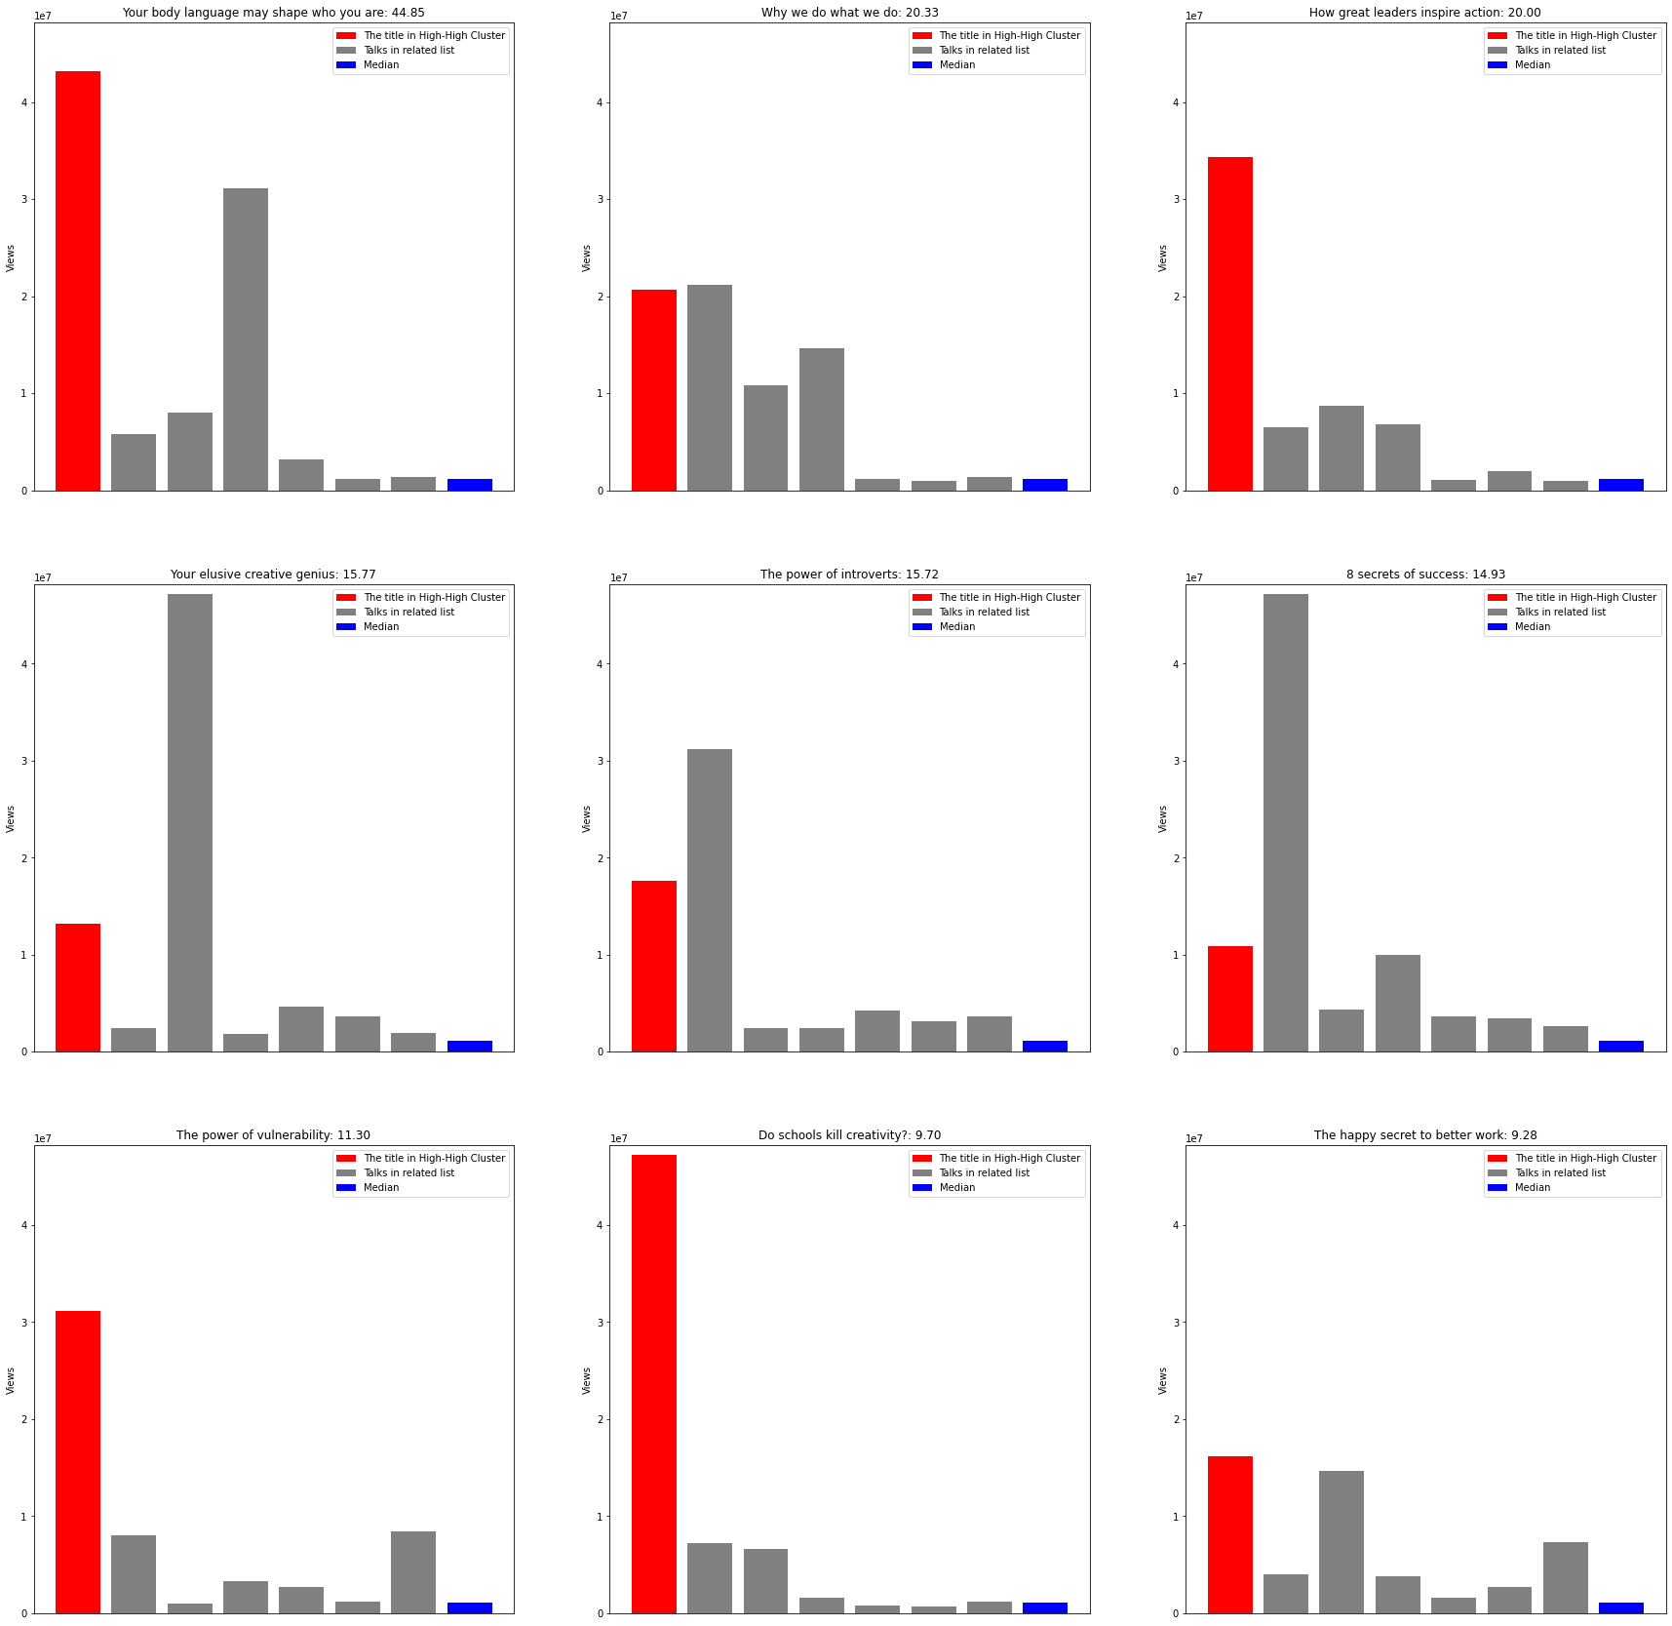
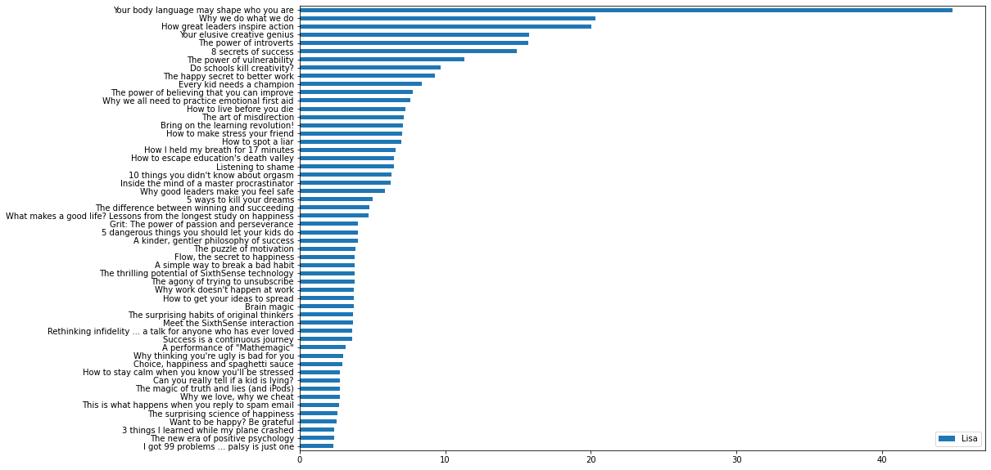
Ted Talks in the High-High Cluster
LISA of Ted Talks in High-High Cluster
Red: High LISA Talk | Gray: Related Talks | Blue: Median

Slide 10
Conclusion
The ted talks generally exhibits a weak positive correlation in the related lists.
From the High-High cluster, the local spatial relationship can be clearly observed.

